Slide 1



PS Code: 1392
Team Name: E-Waste Scouts
Team Leader Name: Mr. Himank Yadav

Slide 2
Basic Details of the Team and Problem Statement
Ministry/Organization Name: Ministry of Environment
PS Code: 1392
Problem Statement Title: E-Waste Facility Locator
Team Name: E-Waste Scouts
Team Leader Name: Mr. Himank Yadav
Institute Code (AISHE): C-25107
Institute Name: Jaipur Engineering College and Research Center
Theme Name: Bin to win ( Mapping Your Green Electronics Path )
Foundation

Slide 3













Idea/Approach Details
Technology Stack
Front end stack :
Developing a software application that facilitates the identification of nearby e-waste collection facilities.
You have the option to manually input your location or allow the system to automatically detect your current whereabouts, which will provide you with comprehensive details regarding the nearby amenities.
In order to effectively influence and educate individuals on the fundamental aspects of electronic waste, our website will comprehensively address these topics through informative articles and engaging animated videos.
If your electronic waste comprises items containing precious metals or chips, you will be eligible to receive reward points corresponding to the condition of the device. Upon accumulating a sufficient number of credit points, you will be entitled to redeem rewards.
In order to obtain credit points, it is necessary to input the device model number, Subsequently, the software will autonomously generate a range of credit points based on the condition of the device.
Additionally, a dedicated ongoing government section on which we will provide comprehensive information regarding initiation aimed at ensuring the safety and preservation of our environment.
This software will enable the users to share their recycling achievements on social media, encouraging others to join the movement.
We will partner with environmental organizations or government agencies to promote our website and collaborate on initiatives to reduce e-waste.
Back end stack :
Other tech stacks :
https://sites.google.com/jecrc.ac.in/bin-to-win/home

Slide 4
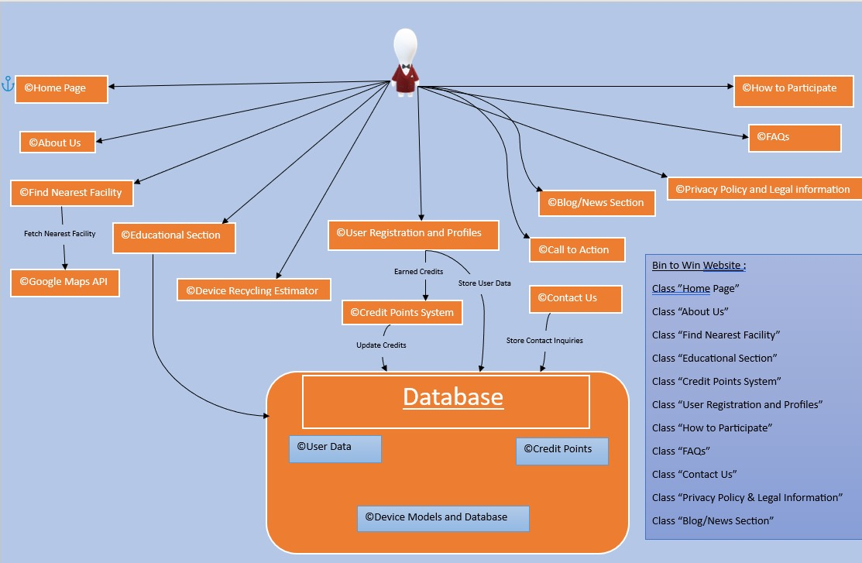
Idea/Approach Details
What makes our project a show stopper/dependencies ?
User case diagram :
In order to enhance interactivity, a weekly quiz competition will be implemented, wherein the winner will be show on the leaderboard in order to encouraging people to join.
We will provide users with the opportunity to sign up for newsletter, which aims to keep them well-informed about the latest updates, new recycling centres, and educational content.
Our team will offer the website in multiple languages to reach a broader audience.
In the help section of the website there will also be a feedback loop to gather user suggestions and continuously improve the website's features and functionality.
In order to enhance the functionality of this software, we have incorporated an NGO section. This feature allows users to conveniently donate to NGOs or become a part of their initiatives by subscribing to the respective NGO pages.
We intend to establish this project as a B2B model, wherein e-waste collectors can acquire additional e-waste from prominent e-waste production centers. Our role will be to facilitate the connection between them.

Slide 5
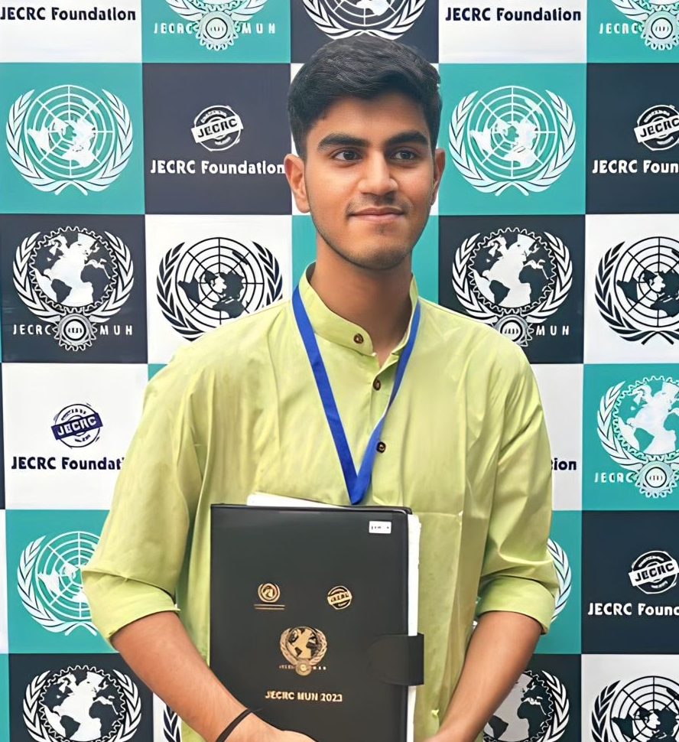
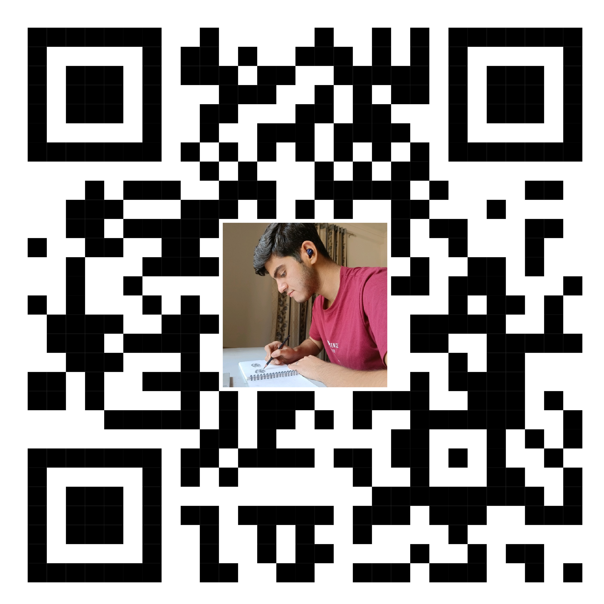
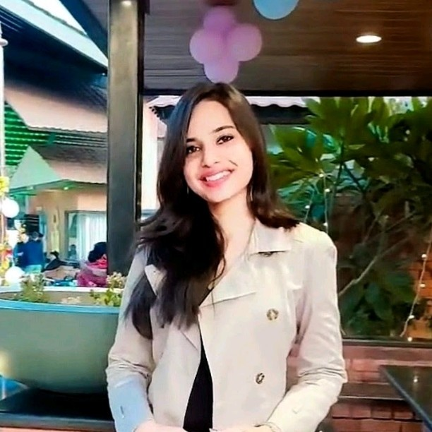
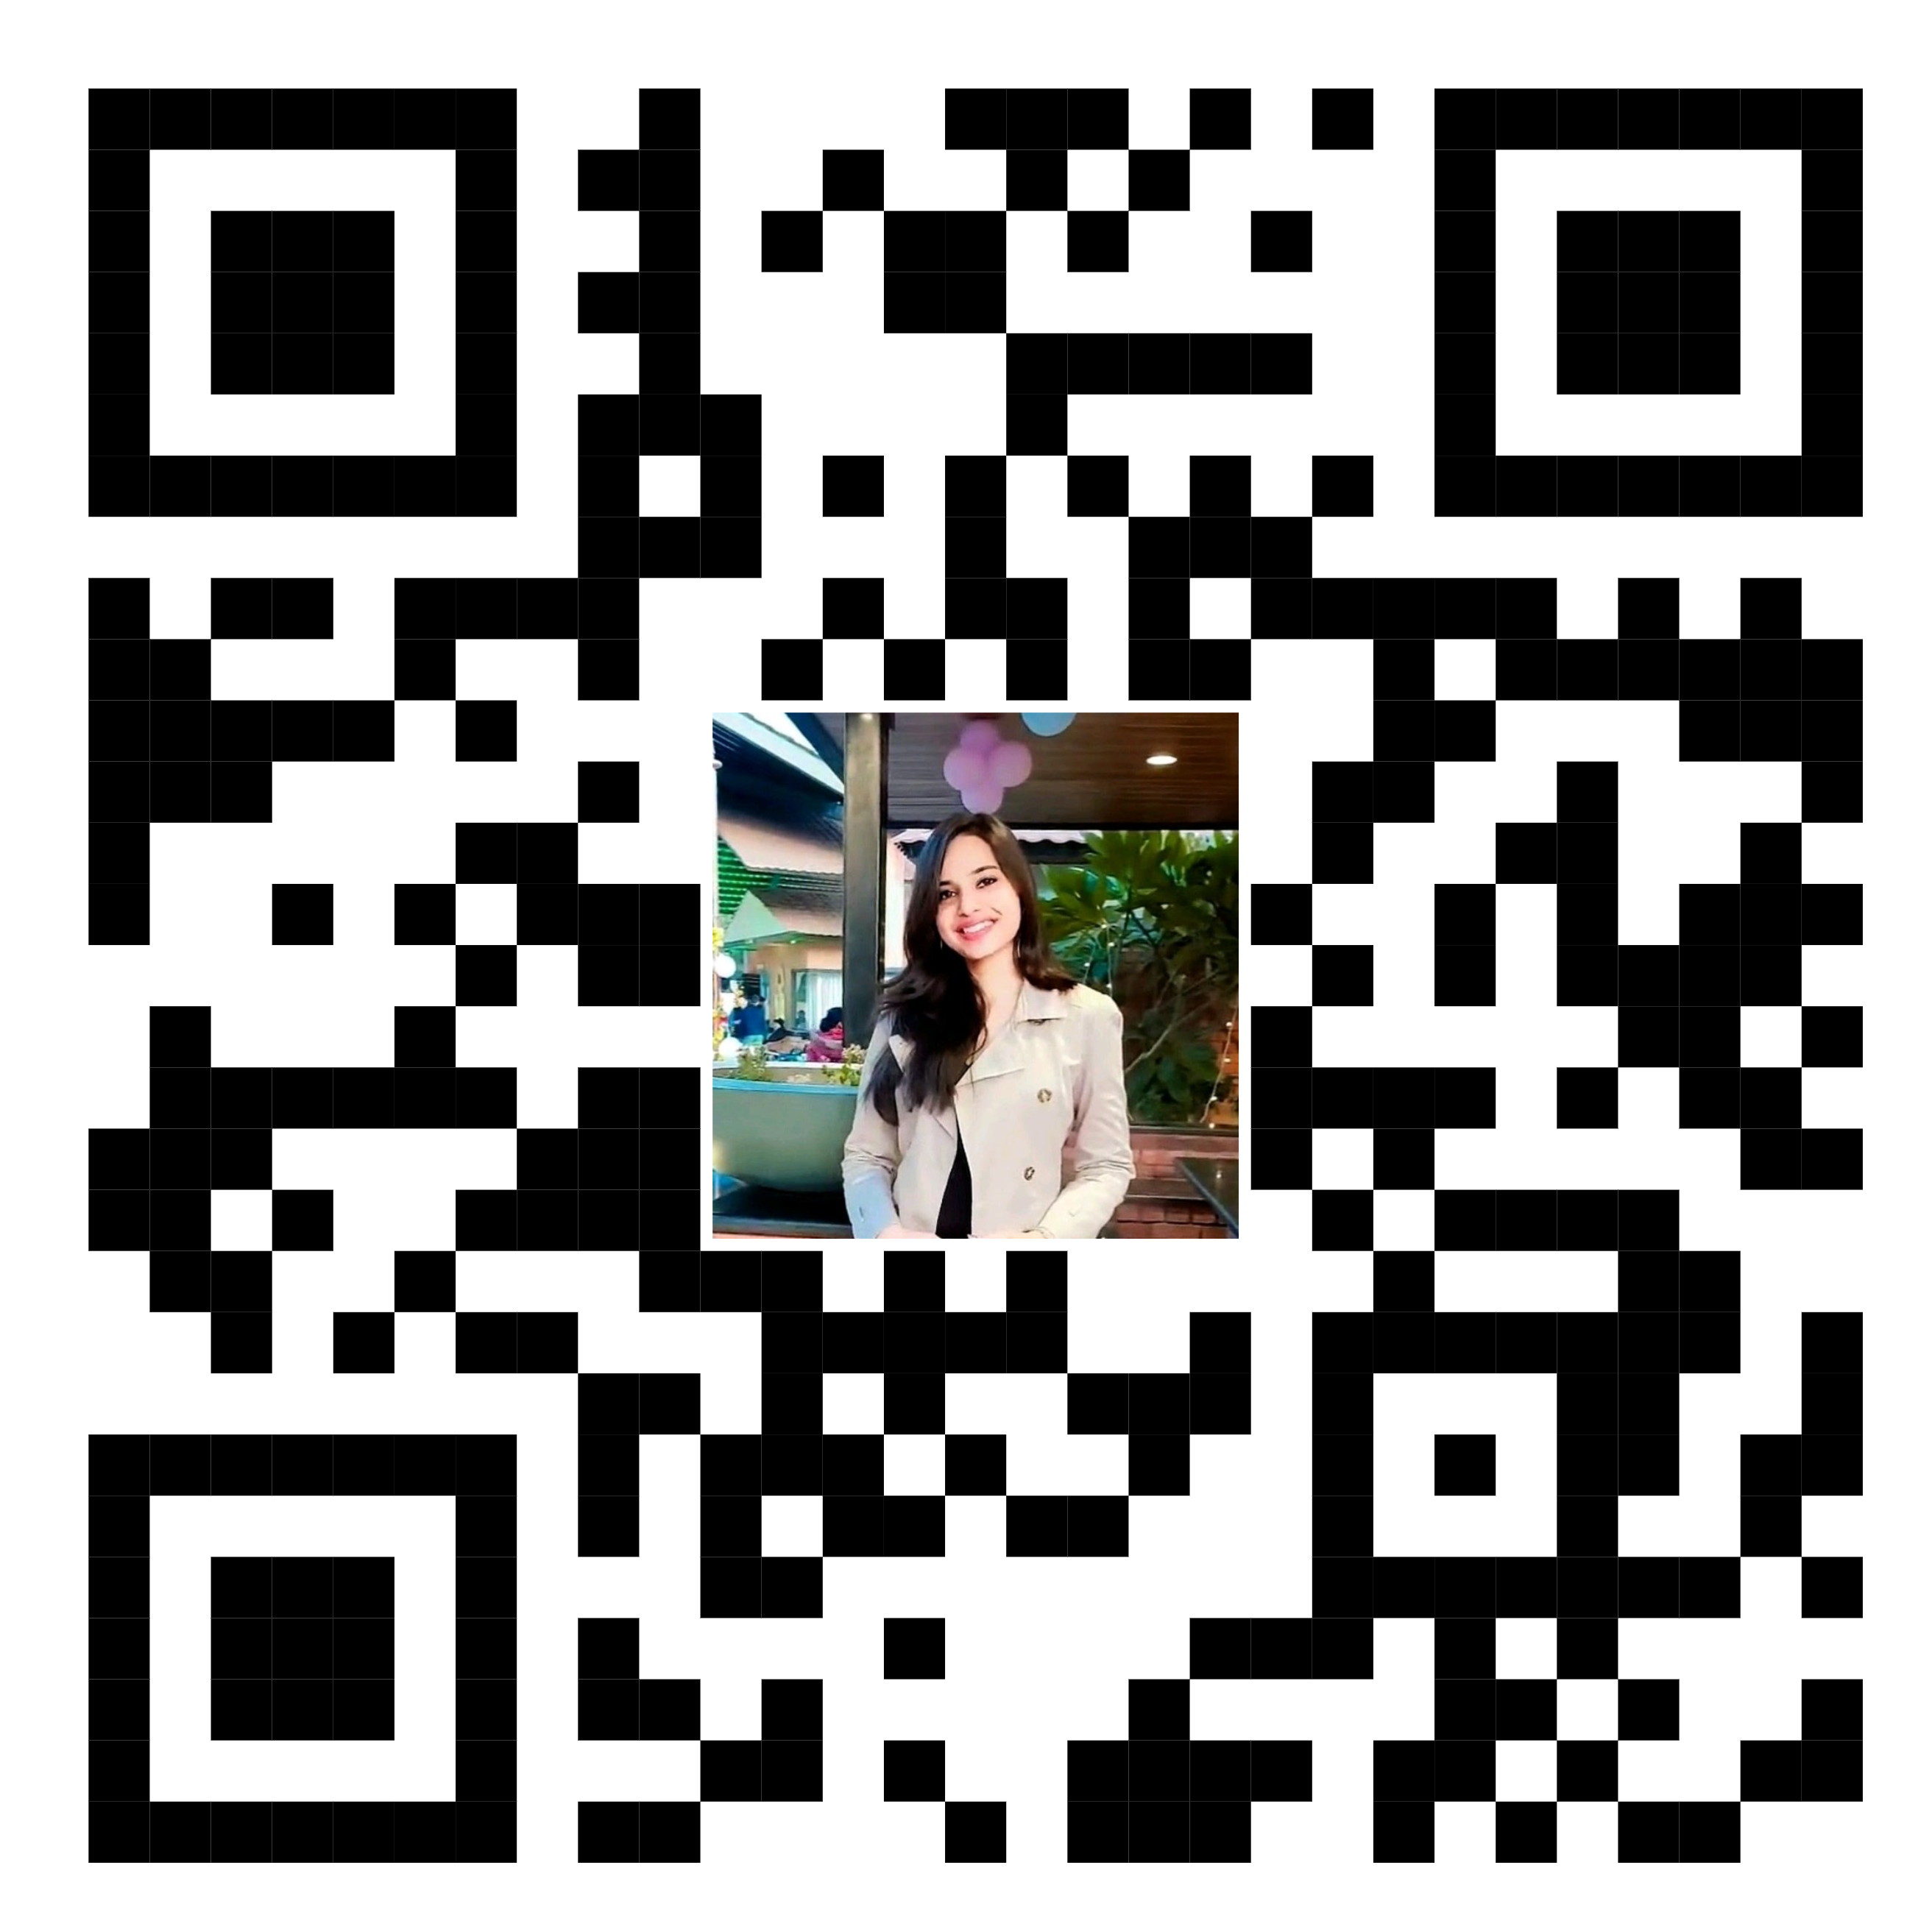
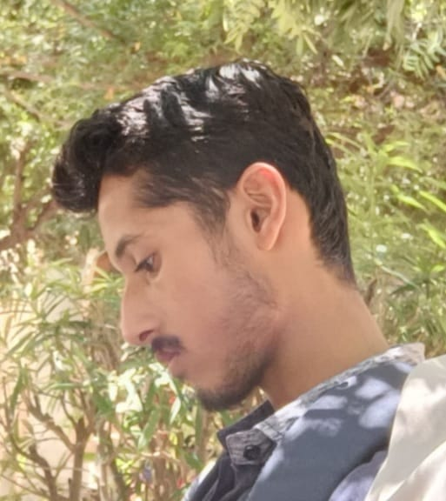
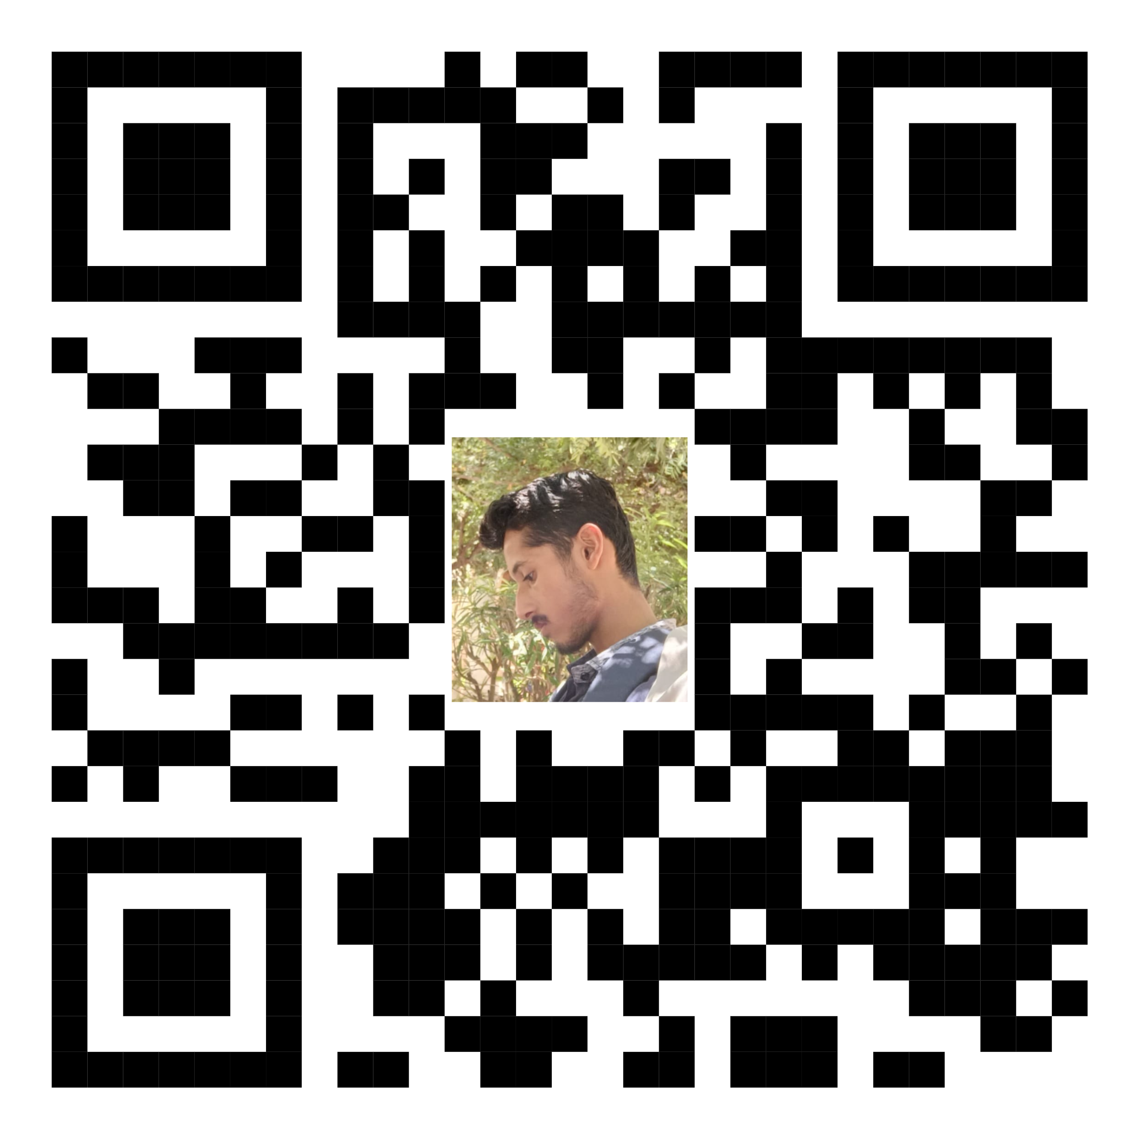
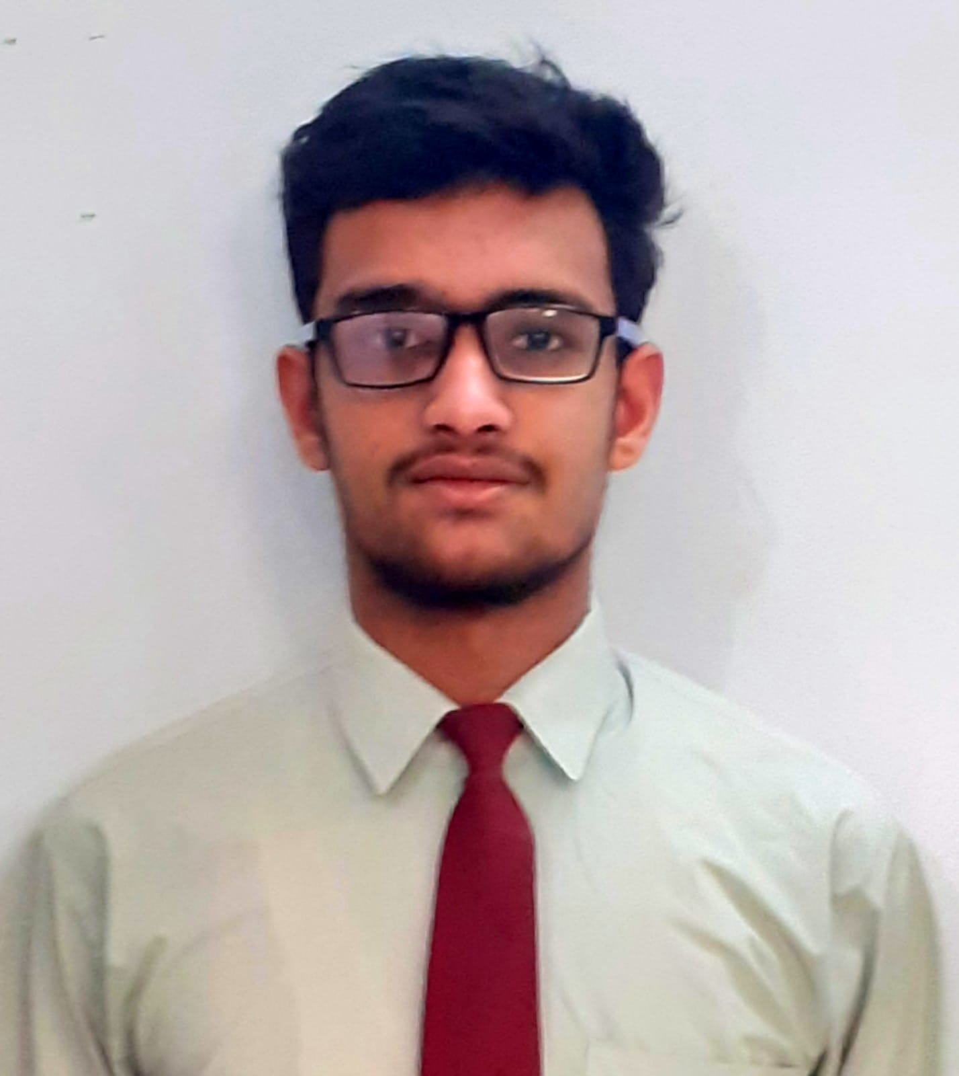
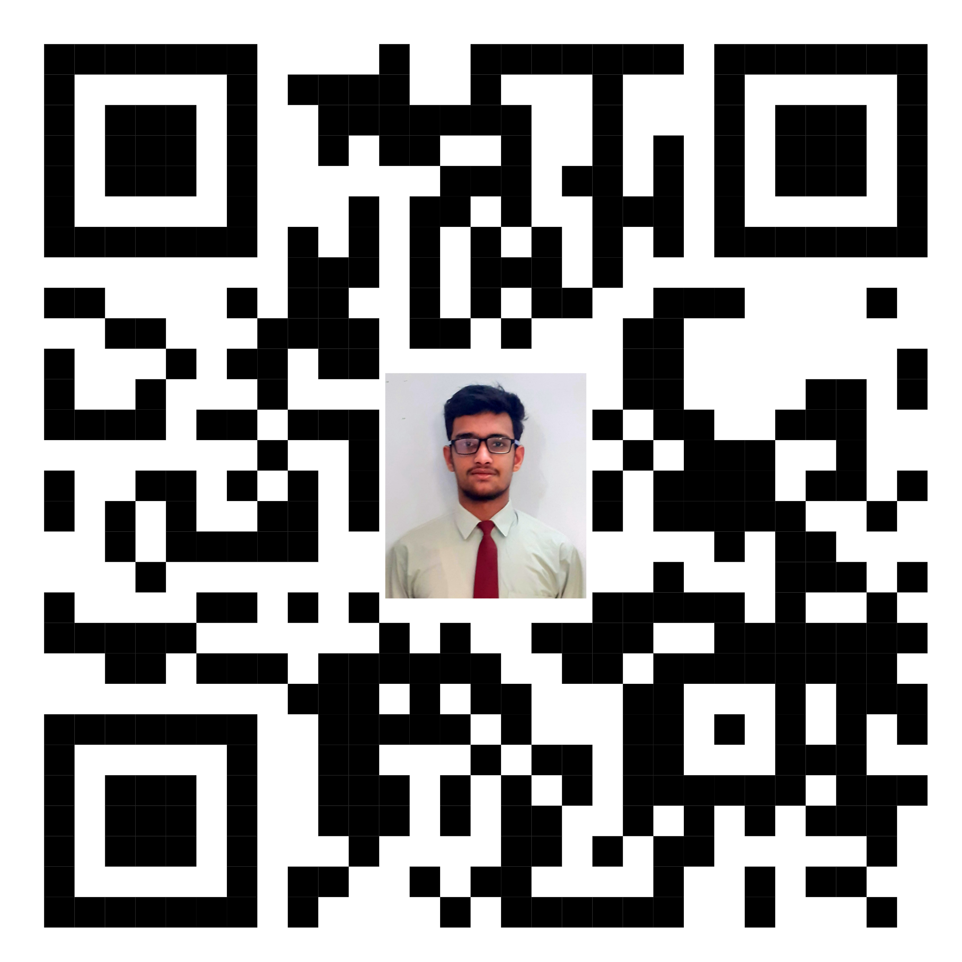
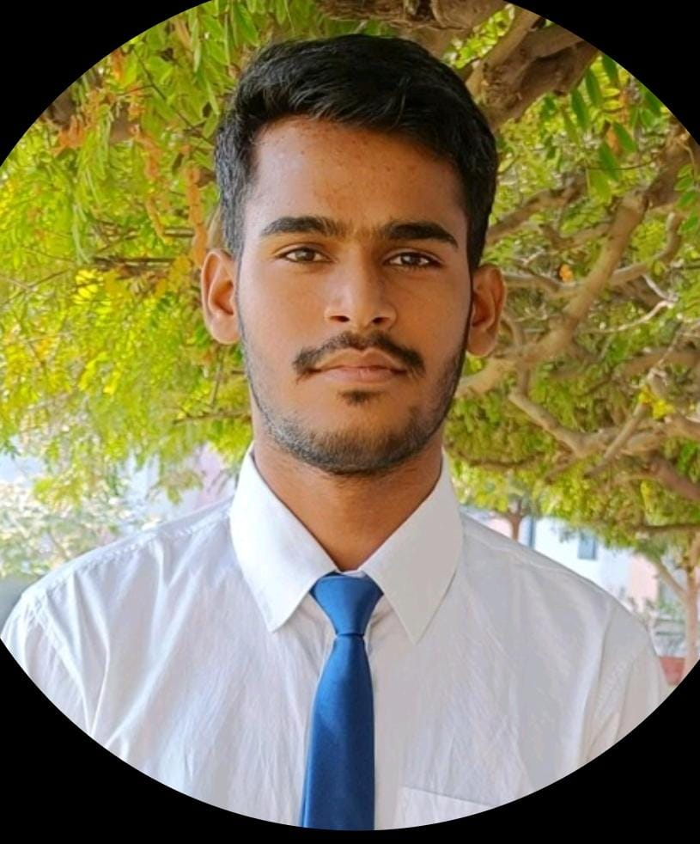
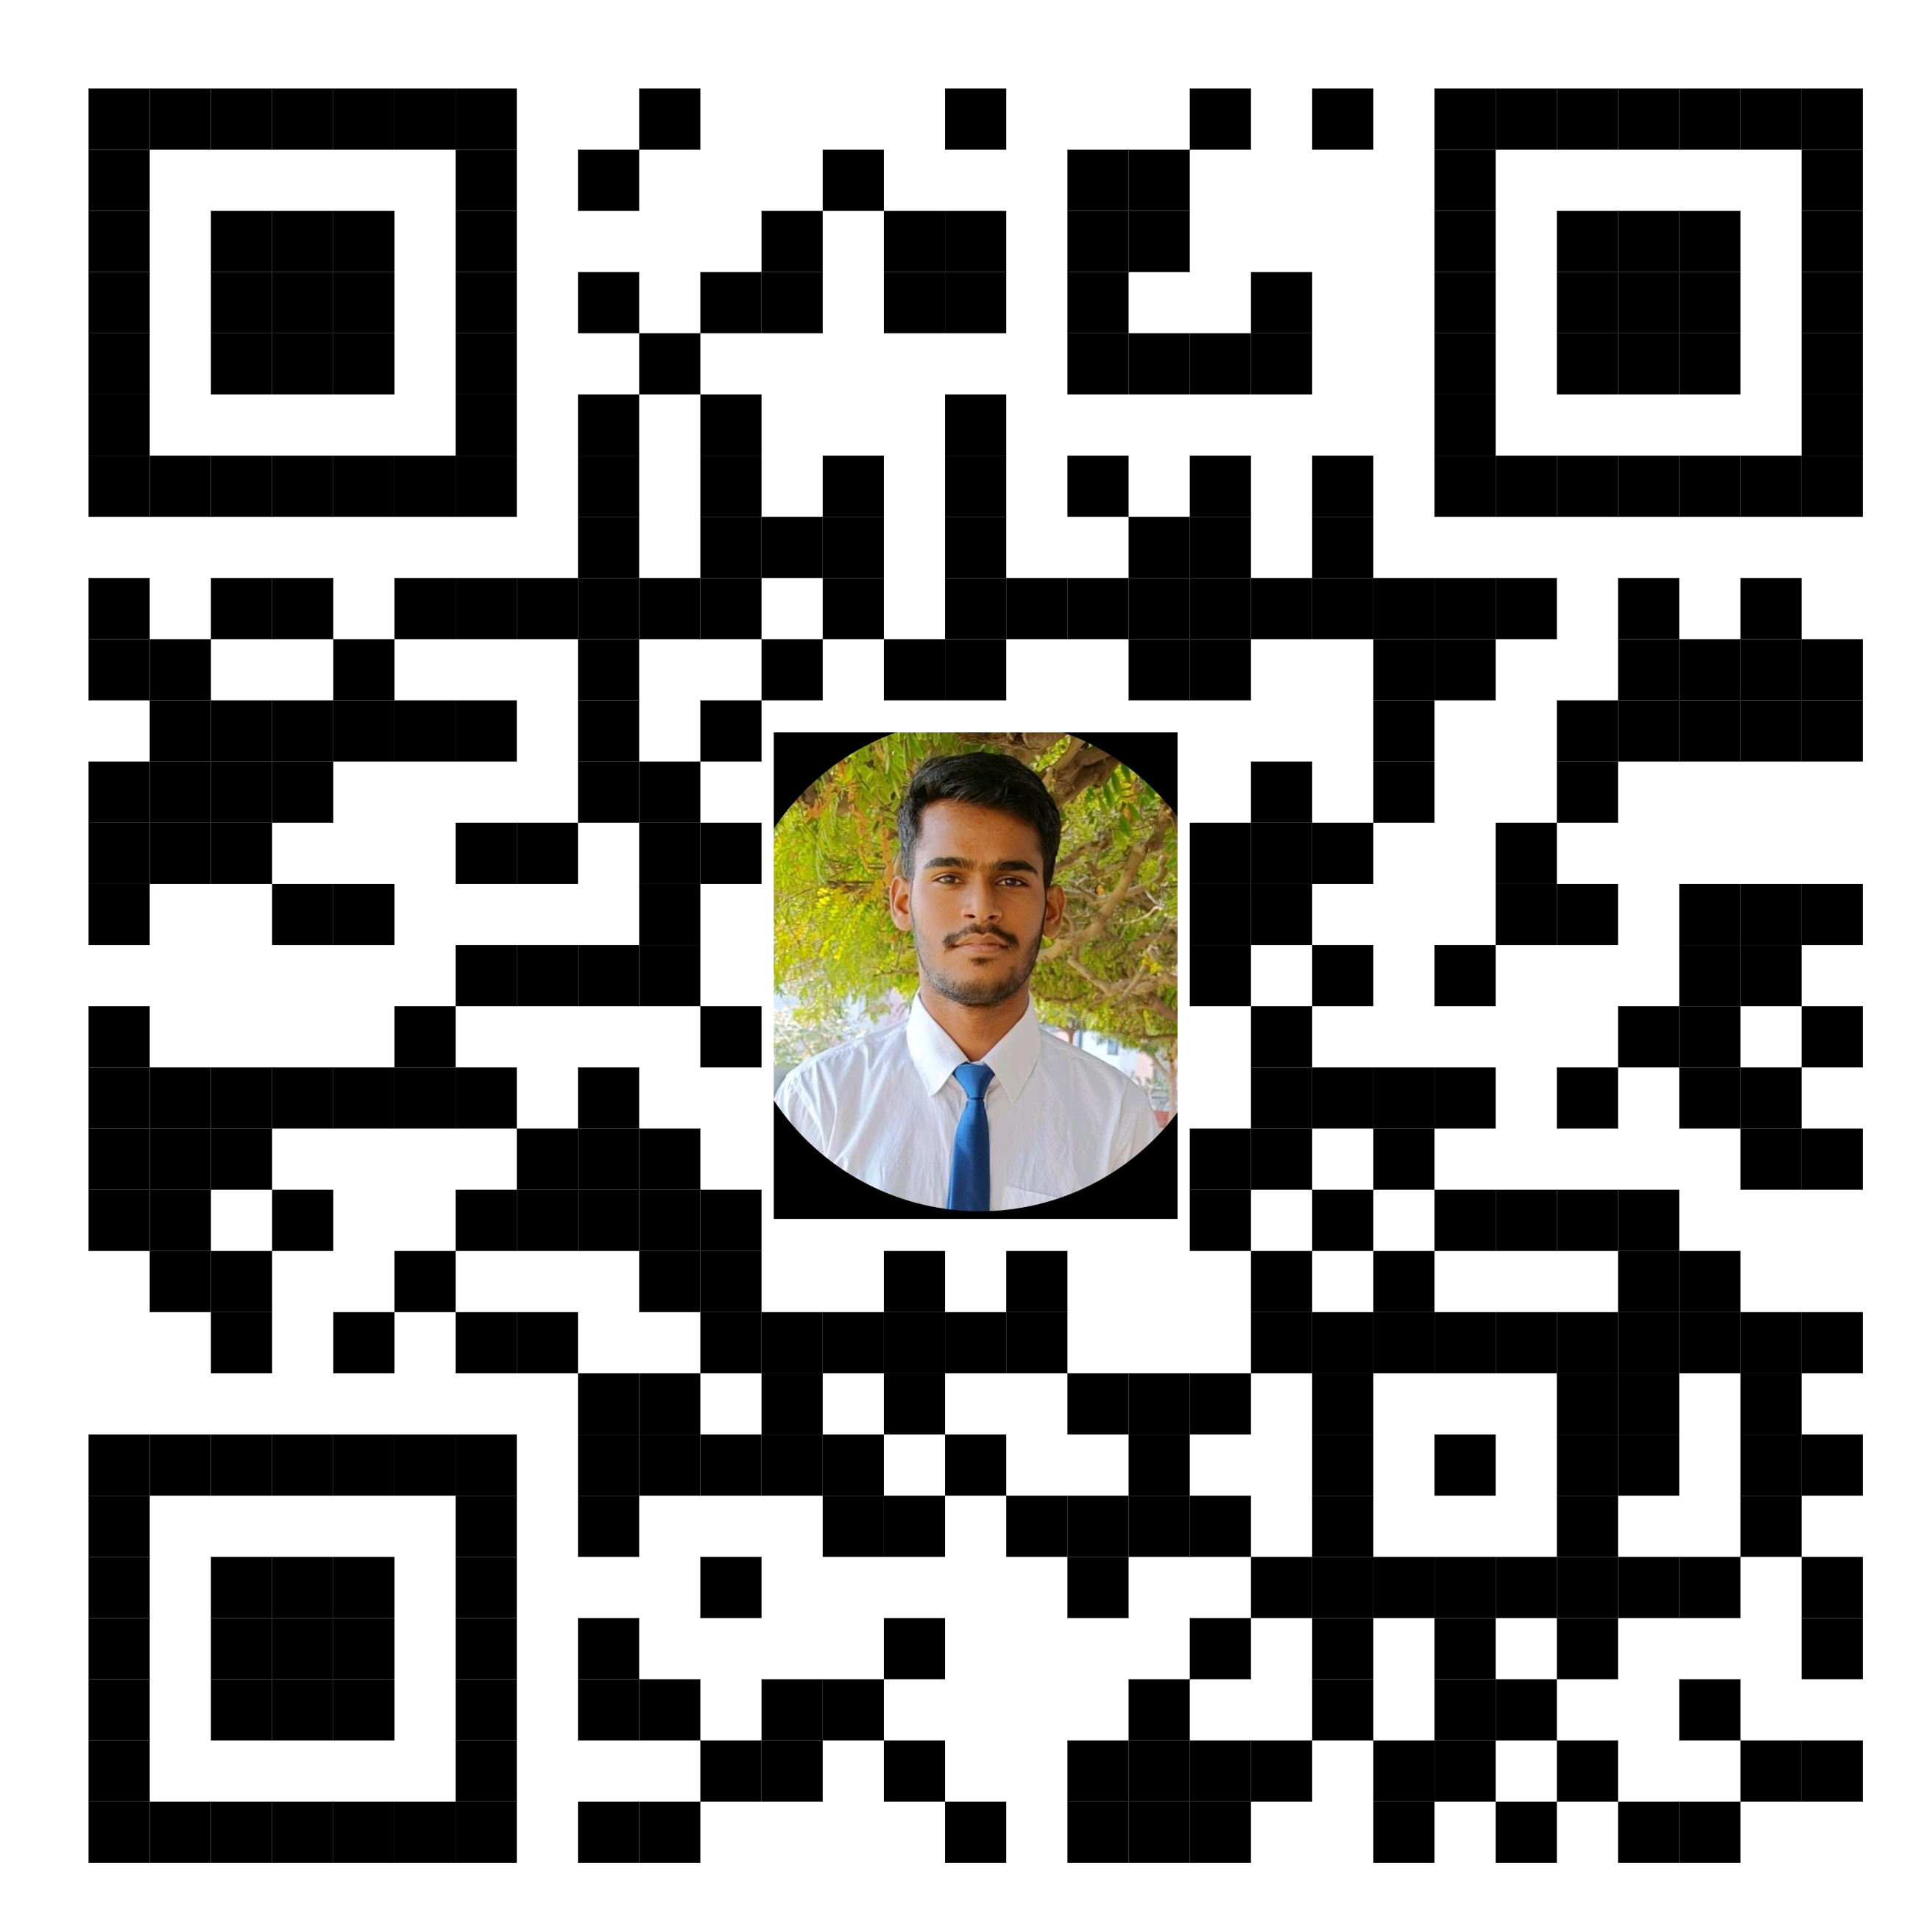
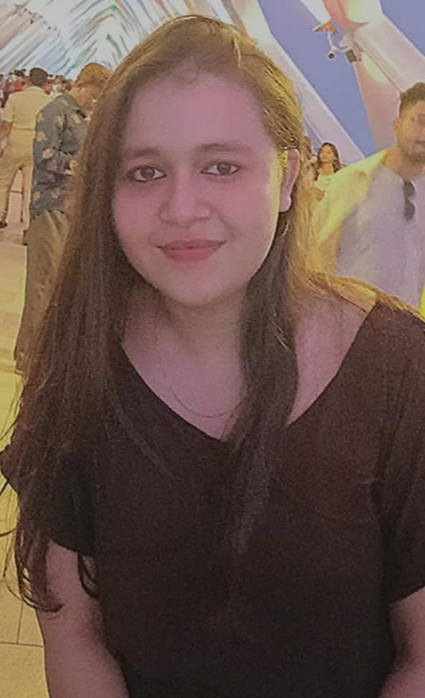
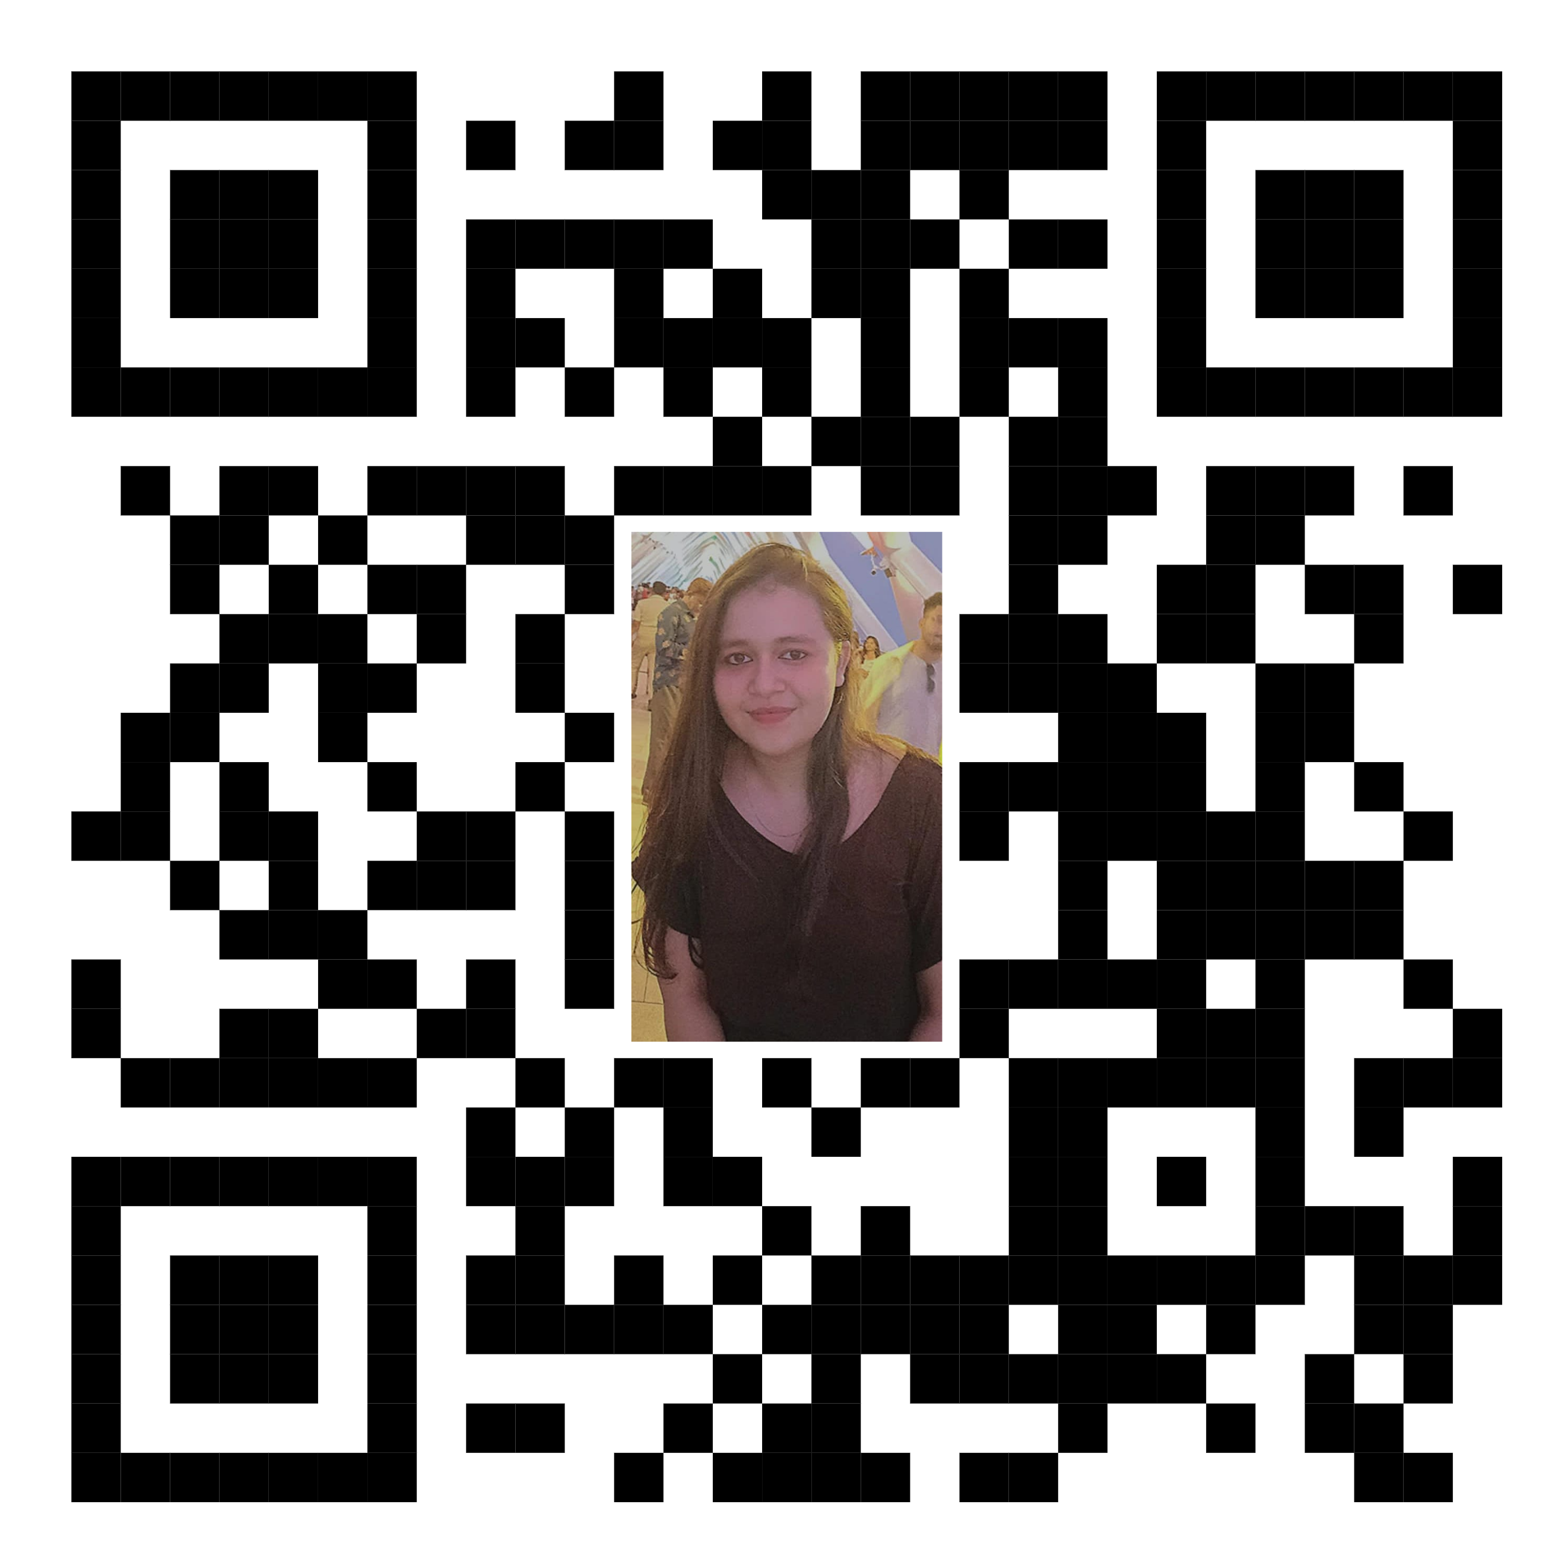
Team Members Details
Team Leader – Mr. Himank Yadav | Branch – B.Tech. | Stream – CSE | 2nd Year
Team Member 1: Name – Ms. Khushi Agarwal | Branch – B.Tech. | Stream – CSE | 2nd Year
Team Member 2 : Name – Mr. Eshan Khandelwal | Branch – B.Tech. | Stream – CSE | 2nd Year
Team Member 3 : Name – Mr. Indresh Mehta | Branch – B.Tech. | Stream – CSE | 2nd Year
Team Member 4 : Name – Mr. Harsh Saini | Branch – B.Tech. | Stream – CSE | 2nd Year
Team Member 5 : Name – Ms. Kamya Vyas | Branch – B.Tech. | Stream – ECE | 2nd Year
Team Mentor : Name – Mrs. Madhu Chaudhary | Expertise – Assistant Professor | Domain Experience – 3 Years

Slide 6
Thank you
.

